Slide 1
Project title
Project information
Notes:
The template outlines the benefits of establishing a Blue School through ProBleu, emphasising advantages such as enhanced reputation, improved student outcomes, and increased community engagement to gain support from the institution. The template sets up the teacher to explain project goals, objectives, and activities to illustrate careful planning and consideration while spotlighting the positive impact on students' learning, the school's reputation, and the wider community highlighting the project's value. In addition, demonstrating a commitment to inclusivity reflects the school's dedication to equity and accessibility, while providing mitigation strategies for potential challenges demonstrates a proactive approach to project management.
The template is editable and can be modified to the teacher’s convenience. The highlighted sections are recommended to be changed.
Examples of project titles: Blue Trails - Navigating ocean literacy for a sustainable tomorrow
Let’s Form Marine Shelters

Slide 2
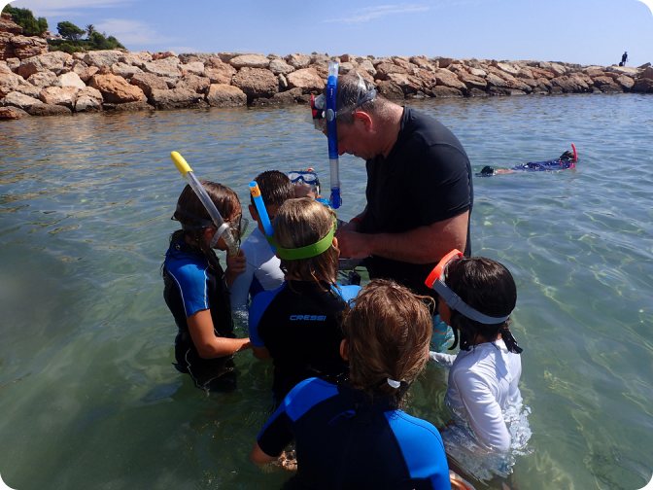

Introduction
The ProBleu funding scheme supports primary and secondary schools in working with children, youth, and the wider school community in the education of the sustainability and protection of marine and freshwater ecosystems.
ProBleu takes an active role in supporting schools, providing the necessary funding for ocean and freshwater literacy projects.
ProBleu projects:
engage students, teachers, school leaders and the wider school community in pursuing ocean and water literacy and sustainability;
develop and implement ideas that contribute to achieving the objectives of restoring the ocean and waters;
are used for the school to join the Network of European Blue Schools.

Slide 3
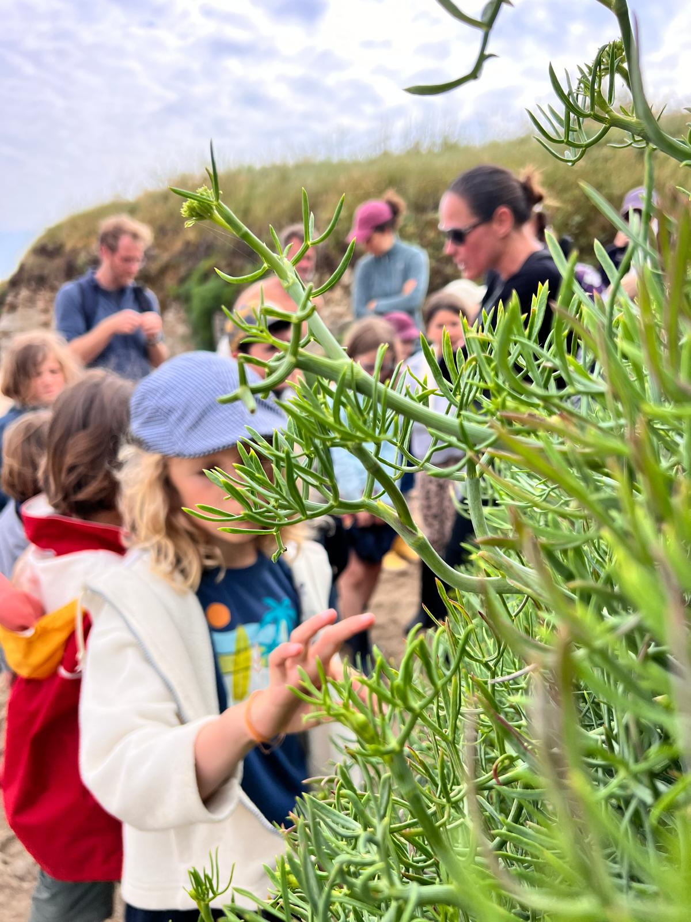
Introduction
ProBleu aims
To increase water literacy in primary and secondary schools across 44 countries
To raise awareness of water issues among young people and to empower them to take action to protect water resources
To give schools the financial and educational support they might need to deliver such projects
ProBleu seeks to create a sense of stewardship and responsibility towards local environments and conservation. By doing so, ProBleu hopes to foster a global culture of sustainability.
ProBleu will provide a repository of marine and freshwater education resources. https://probleu.pml.space/en/

Slide 4
List of eligible countries
Albania | Finland | Lithuania | Republic of Cyprus
Armenia | France | Luxembourg | Romania
Austria | Georgia | Malta | Slovakia
Belgium | Germany | Moldova | Slovenia
Bosnia and Herzegovina | Greece | Montenegro | Spain
Bulgaria | Hungary | Morocco | Sweden
Croatia | Iceland | Netherlands | Serbia
Czechia | Israel | North Macedonia | Tunisia
Denmark | Italy | Norway | Türkiye
Estonia | Kosovo | Poland | Ukraine
Faroe Islands | Latvia | Portugal | United Kingdom
Notes:
Highlight your country in the list

Slide 5
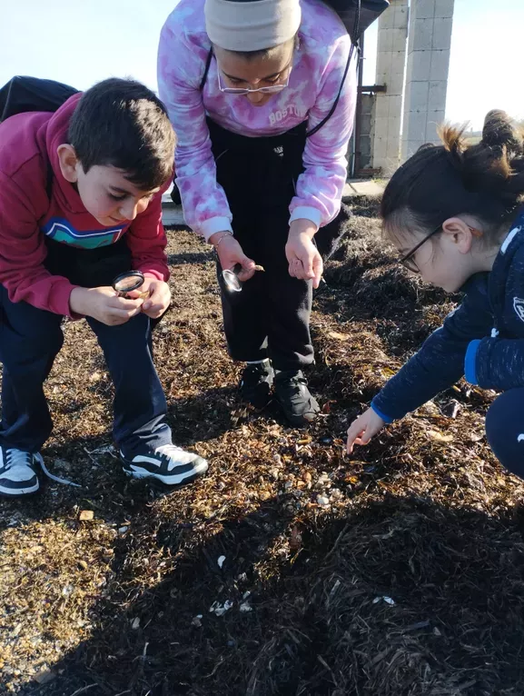
Benefits of participating
Inspire kids, introduce citizen science
Funding can be used to purchase equipment, resources or training which can benefit the school and the wider school community beyond the end of the project.
Support from ProBleu to join the Network of European Blue Schools
Cooperation with other schools through twinning activities
Participating in a large international project with potential visibility in over 40 countries
Access to teaching materials provided by ProBleu
ProBleu encourages activities related to citizen science, facilitating collaboration between educators and scientists to bridge the gap between scientific research and education.

Slide 6
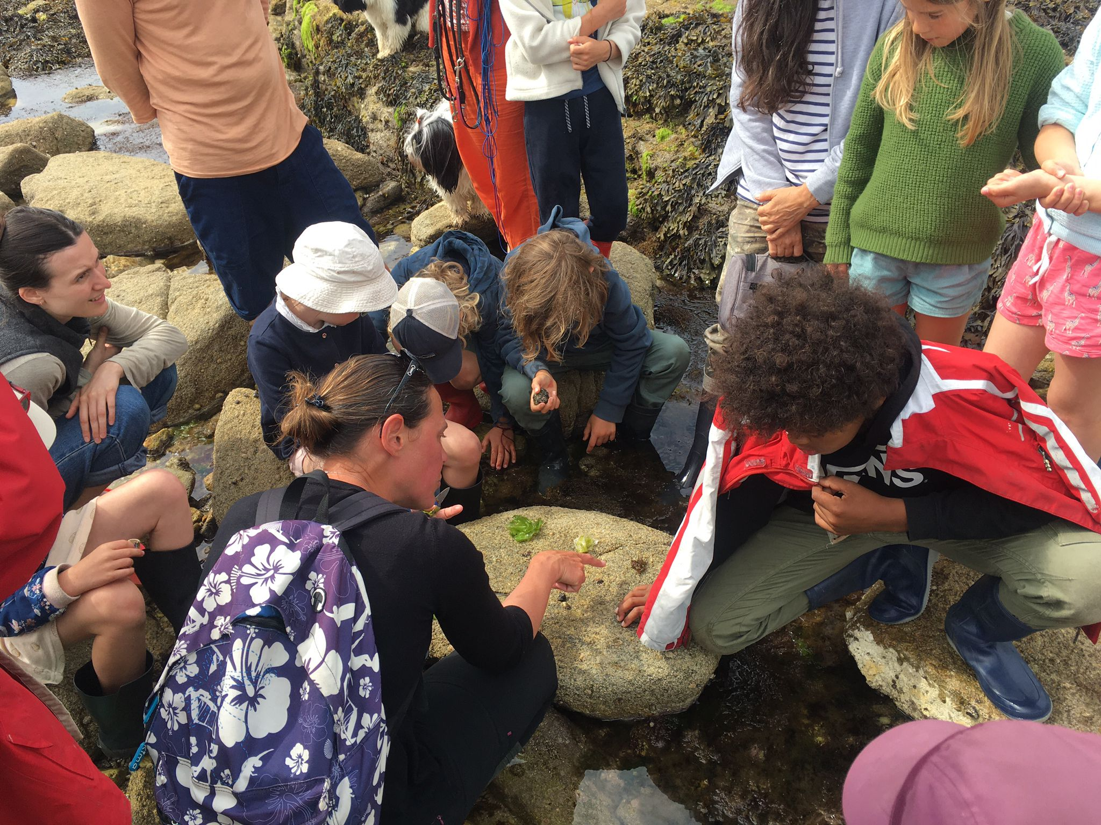
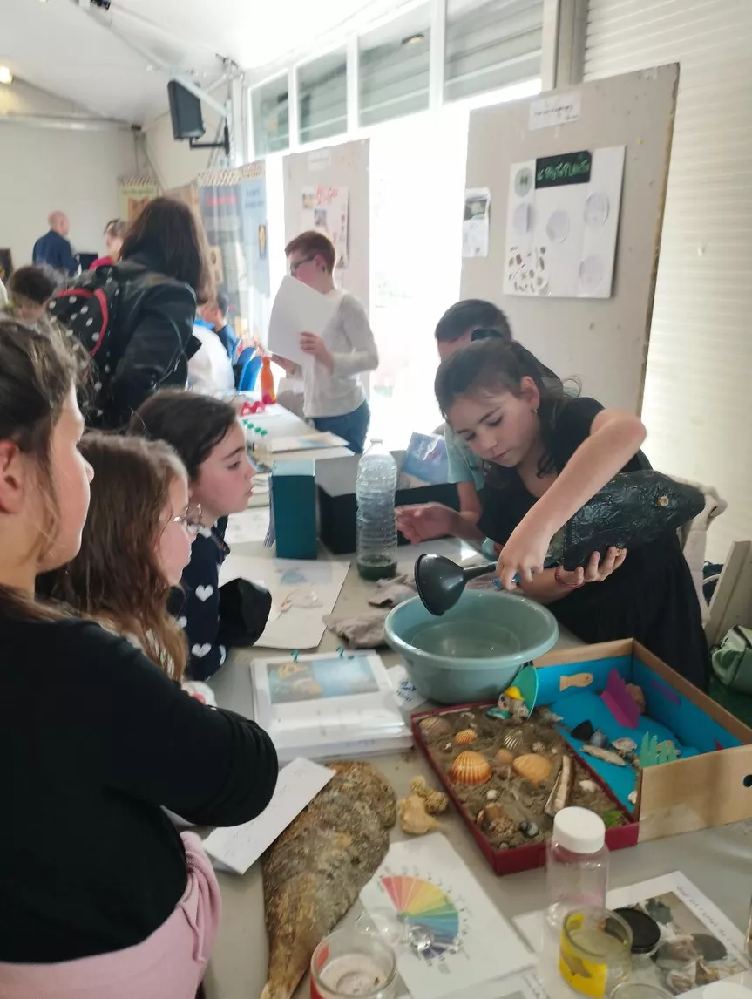
Activities
Data collection
Workshops, meetings, conferences, training, field trips, exhibitions
Development and delivery of teaching units, individual lessons and practical exercises
Research-based activities
Creative performances
Documentaries filmed by students
Competitions
Collaborating with other schools

Slide 7
Available funding
For small-scale projects
up to € 2500
For medium-scale projects
up to € 5000
For large-scale projects
up to € 7500
The funding covers expenses such as:
Travel
Accommodation
Subsistence
Purchase and renting of equipment
Consumables
Subcontracting

Slide 8
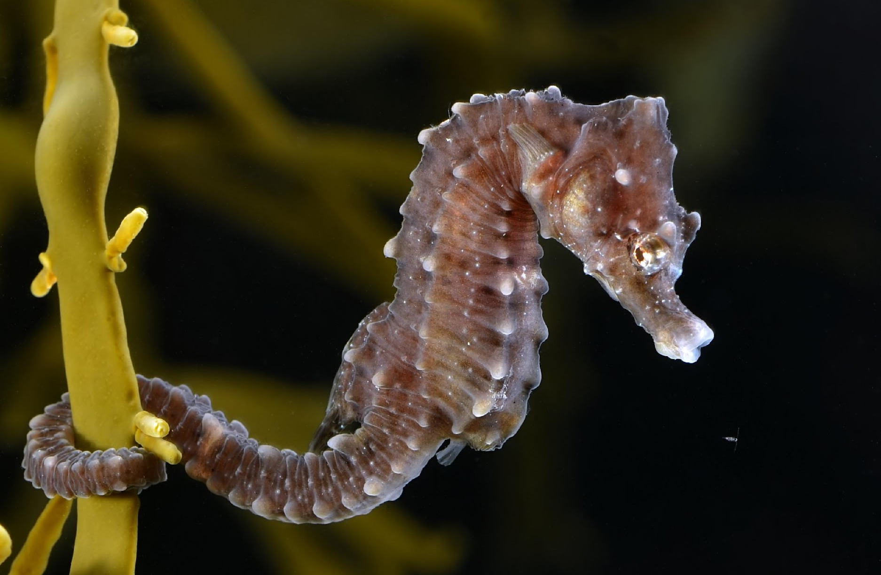
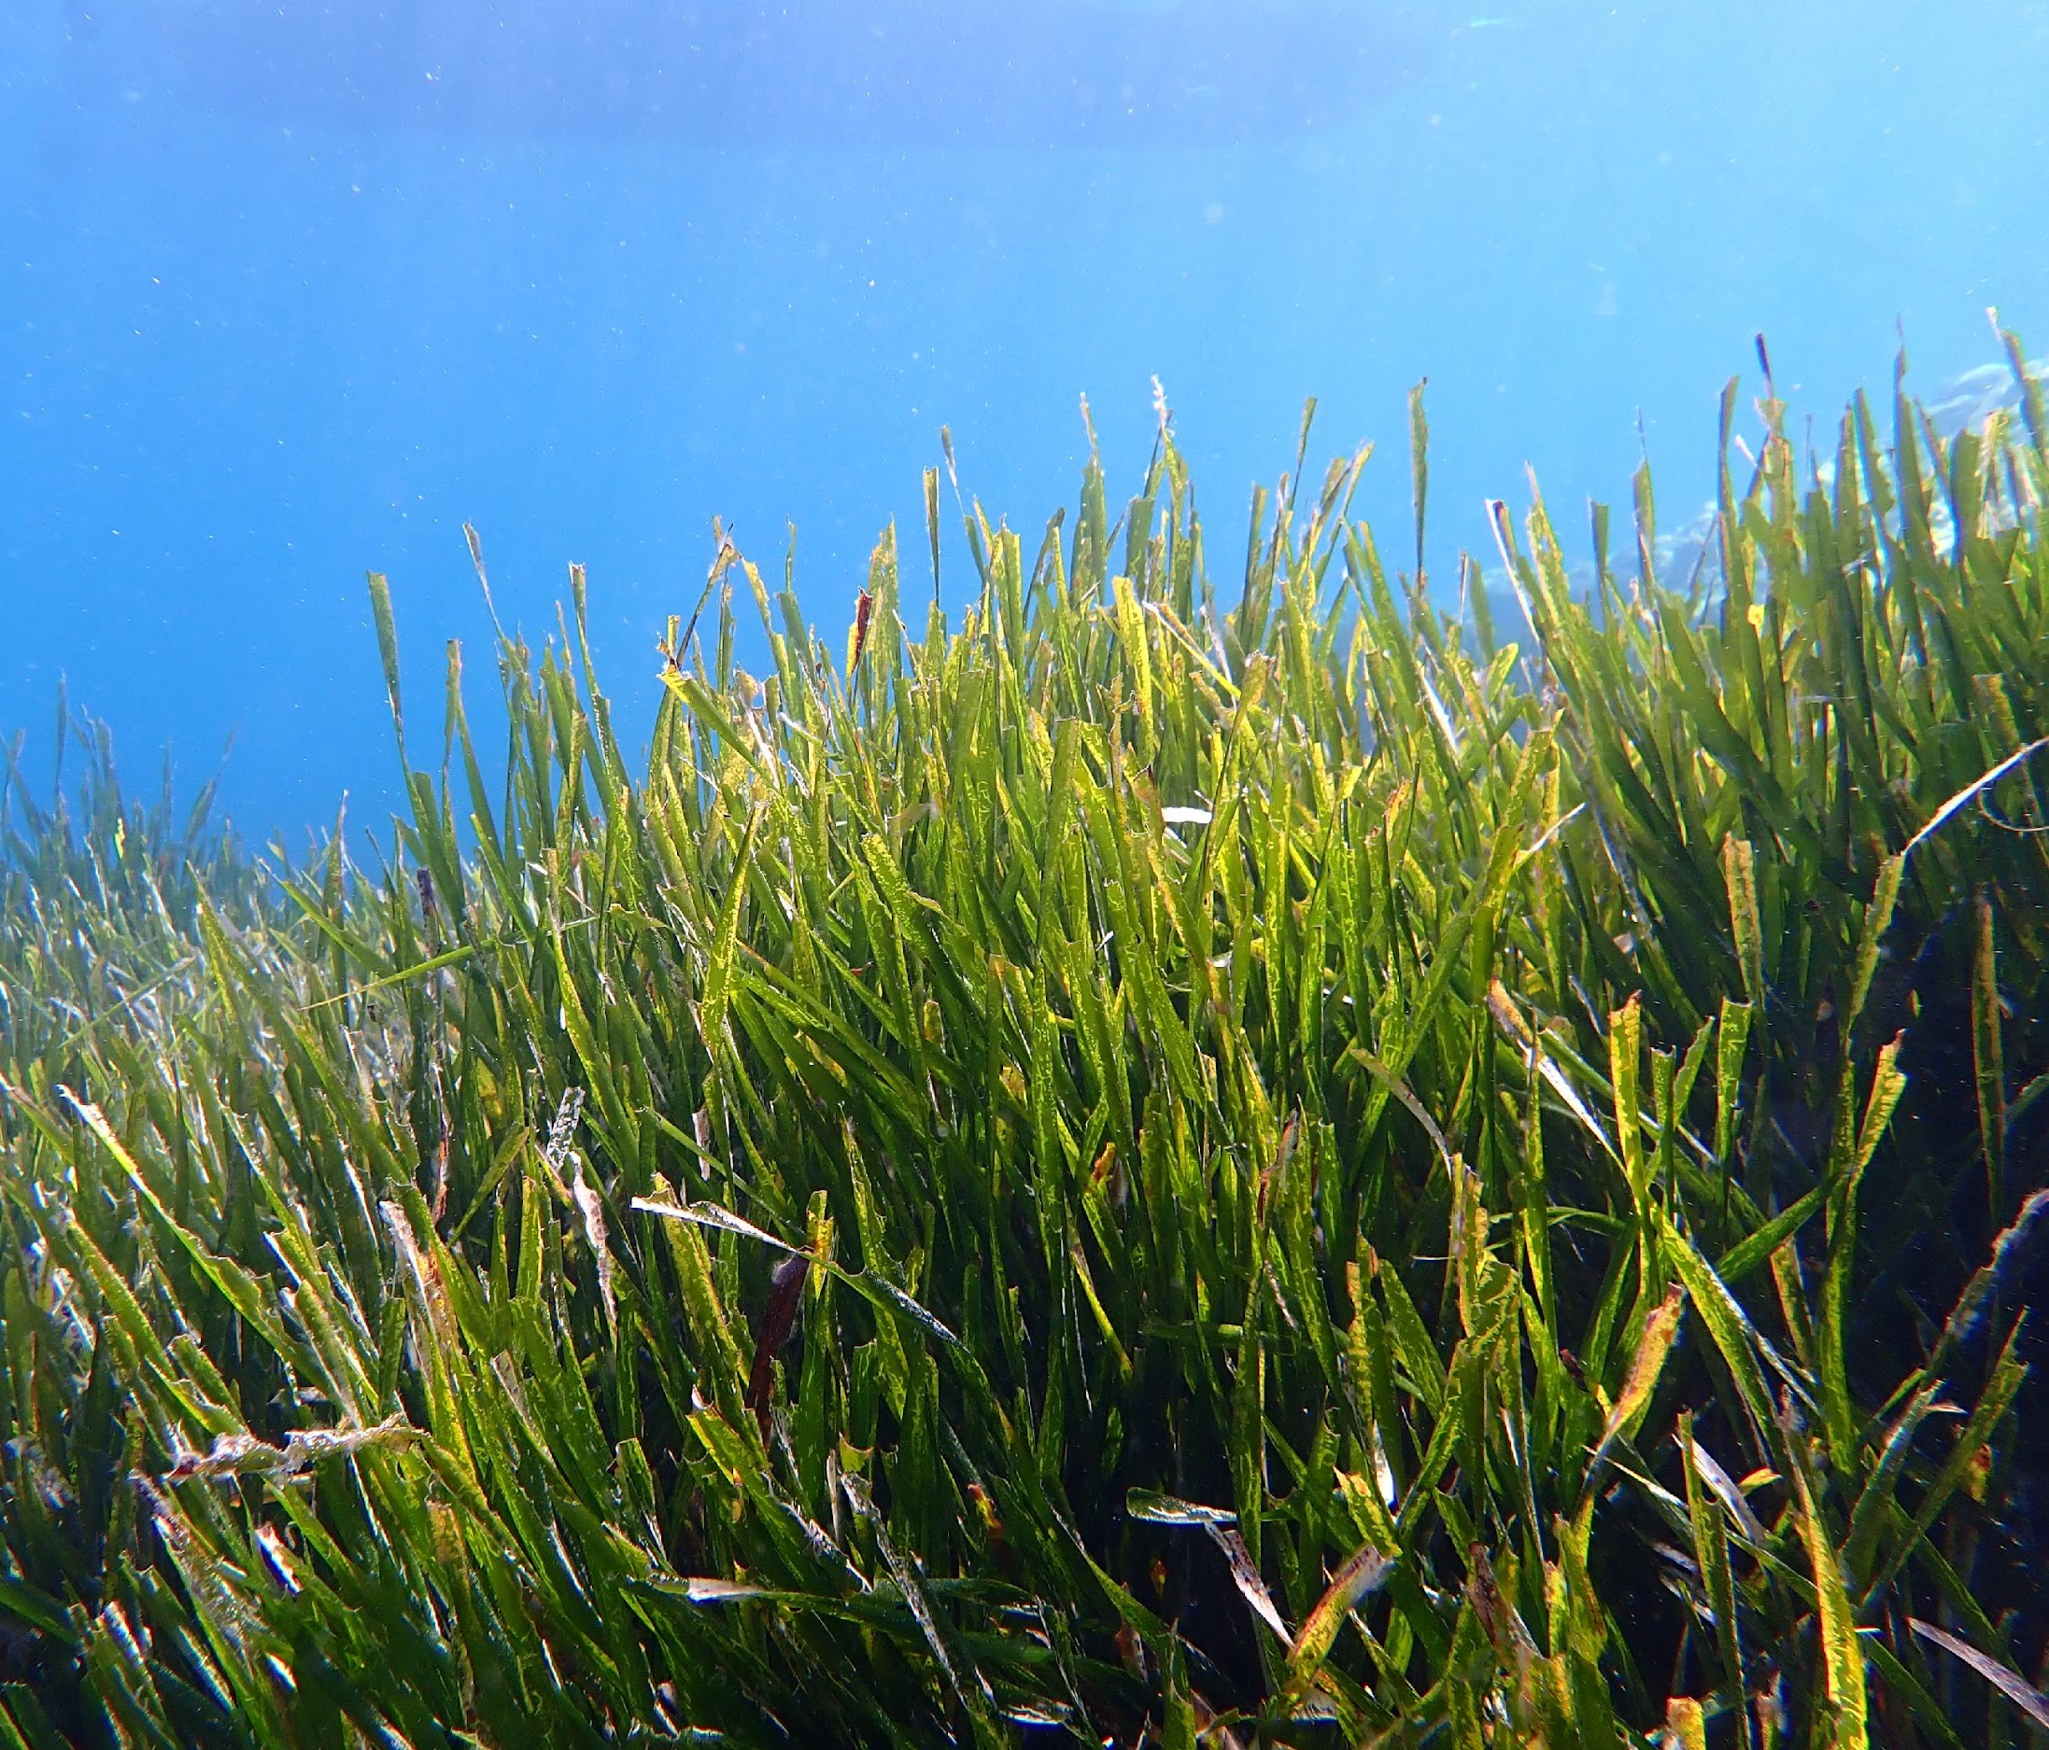
Funded project example on marine environment
‘Let’s Form Marine Shelters’ – Secondary school marine project in Spain
The project is based on teaching students about the critically endangered species Syngnathus hippocampus and its habitat.
This species attracts attention, improving the learning interest of the participants. In addition, it is linked to Posidonia oceanica, a marine plant endemic to the Mediterranean, which has a vital role as a CO₂ sink, oxygen supply and habitat for many species.
The students are collecting data on seawater quality and the presence of biota.
Experts will guide educational workshops on the species, habitat and current status.
The students will design a model seahorse ‘hotel’ with biodegradable materials to promote species conservation, which divers will install on the seabed.
Educational videos and informative leaflets will be developed in three languages.
The project will work with other schools, experts in the field and the local fishing community.
Notes:
Add your project description

Slide 9
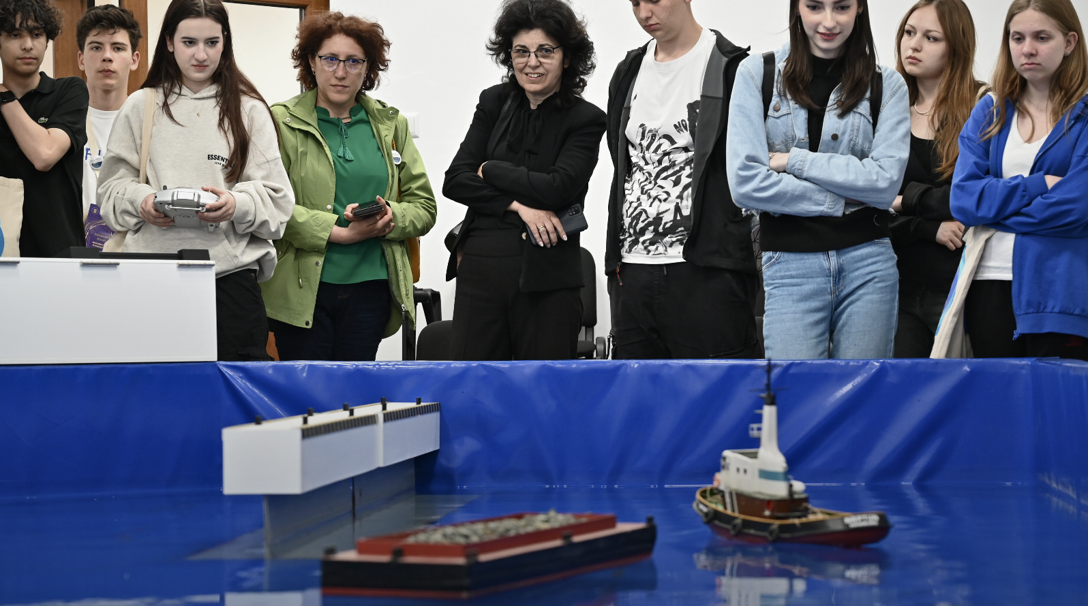
Funded project example on freshwater
‘Blue Trails - Navigating ocean literacy for a sustainable tomorrow’ - Secondary school freshwater project in Romania
This project will collect and analyse data on microplastic water pollution in local lakes and rivers. A map of water quality in Romania will be produced using data collected by the students.
The school will partner with three other schools in Romania and will work with local partners, such as research facilities, universities, and NGOs.
Students will research methods to clean water from microplastic pollution; this will challenge the students and encourage innovative ideas.
Each of the three schools will develop its own water-related project relevant to its community. They will also design a program to reduce single-use plastic in their schools.
Exchanges will take place between the schools, and a group of students will visit another school to exchange the results of the projects. Each school exchange will involve a community event held by the host school to promote project results.
Notes:
Add your project description

Slide 10
Funded project example – Small scale
‘Raise awareness of students on the services of algae in their surrounding coastal ecosystems, and their value as a sustainable food source.’ – Primary school marine project in France.
Raise awareness of students and the wider school community on the possibility of eating algae that grow in local coastal habitats.
The project aims to contribute to a shift in society towards healthier and more sustainable diets.
Students will go on outings with a professional algae harvester. After each harvest the students will cook the algae with a local chef who uses algae in their cuisine.
The students will create an art exhibition around algae and a guide for collecting and eating algae which they will display during the city's sea festival. They will share with the community how to collect and eat algae, and the other services provided by these species.
This guide will be printed and handed to every school student for them to use as well as their families and the extended school community.
The project addresses the topic of "reducing over-fishing" by proposing an alternative to the consumption of fish.
Notes:
Add your project description

Slide 11
Activities planned - Example
‘Blue Trails - Navigating ocean literacy for a sustainable tomorrow’ - Secondary school freshwater project in Romania
We'll have several steps in implementing our project
for the first objective (increasing the number of students attending ocean sciences workshops) we'll prepare a curriculum (content, activities, evaluation) that we’ll deliver by the students, for the students (in Romania the school year includes a Green Week, with special activities/schedule that it is very suitable for our plan). The trainer students will attend a 2-hour meeting to set all the details of their "job". After each workshop, a feedback form will be provided to the participants to improve the quality of the next events
for the second objective (expanding the microplastic research on the freshwater body nearby), we'll create a new team of 10 students, and we'll use the procedure we developed beforehand for those new environments
for the third objective, creating a partnership with 3 other Romanian schools, we'll create an info sheet with all the details of NEBS (applying procedure, deadlines, types of projects etc) and the support we can offer for the schools to develop their project and apply to become a part of NEBS. After setting the communication with the schools, we'll decide together the topic of their project and we'll set an exchange program among the schools, with 6 exchanges for 8-10 students and 1-2 teachers each, with a duration of 2-3 days (it is a system used for the European projects but no with schools from the same country, therefore we think it will be appreciated by the students). During the exchanges, the students will work together on relevant local water-related topics, with the help of the local partners (research facilities, universities, NGOs) and we'll exchange the results of the projects already developed by each school. We have selected schools from these towns because each one has its specific features, as water ecosystems and communities’ peculiarities.
Notes:
Add details about your project activities

Slide 12
Budget
Resource | Amount
For 6 exchanges - exchanges accommodation and meals costs | 66 participants x 1 days x 30 EUR = 1980 EUR
Transportation | 2 teachers x 125 EUR = 250 EUR
Local transportation (in the cities and excursion) | 5 exchanges x 200 EUR = 1000 EUR
Equipment – kit for sea water quality | 780 EUR
Equipment – kit for freshwater water quality | 750 EUR
Administrative expenses (website) | 240 EUR
Total : 5000 EUR
For medium-scale projects (up to € 5000)
Notes:
Explain budget

Slide 13
Sustainability practices – example
For the Workshops:
Minimise waste: Use reusable materials for handouts, decorations, and refreshments.
Reduce energy consumption: Ensure the workshop venue is energy-efficient and use natural light whenever possible.
Promote sustainable transportation: Encourage participants to use public transport, cycling, or walking to attend the workshops.
For the Microplastic Research:
Minimise waste: Use reusable equipment and materials for the research activities.
Ethical sampling: Ensure that microplastic sampling methods do not harm aquatic organisms or ecosystems.
Data management: Use digital tools to collect and store data, reducing paper waste.

Slide 14
Student participation - example
Accessibility: Ensure that all activities are accessible to students with disabilities, including those with physical, sensory, or learning impairments. This may involve providing accommodations such as sign language interpreters, assistive technology, or modified activities.
Cultural Sensitivity: Incorporate activities that are culturally relevant and respectful of all students' backgrounds. Consider the diverse cultural perspectives and experiences of students when designing and implementing activities.
Diverse Participation: Encourage participation from all students, regardless of their academic abilities or interests. Offer a variety of activities to cater to different learning styles and preferences.
Risk | Potential Consequences | Mitigation Strategies
Safety hazards | Injuries, illnesses | Risk assessment, safety training, equipment, supervision
Environmental impact | Habitat damage, pollution | Environmental guidelines, impact assessment, mitigation measures
Ethical considerations | Data privacy breaches, cultural insensitivity | Ethical protocols, informed consent, cultural sensitivity training
Project delays | Disruption of activities, missed deadlines | Contingency planning, flexible scheduling, open communication

Slide 15
How to apply
The funding calls:
Call 4:
Call Opens: March 21, 2025.
Submission Deadline: May 23, 2025, 23:59 CET.
The application process details will be available on the ProBleu website https://probleu.school/
The ‘Call for proposals’ document will contain all relevant information.
You will be required to fill out a project description form, detailing the project you wish to carry out.
Requirements:
This call is directed at primary and secondary-level schools (including vocational schools- Schools providing up to ISCED level 3, commonly designated as upper secondary education.)
Eligible applicants: the “applicant” must be a school with legal status that applies for financial support. It therefore must be the school which receives the funding.

Slide 16


Other funding options
Explore, SHORE and BlueLights, are also dedicated to enhancing ocean literacy in school communities. They have innovative initiatives and funding opportunities!

Slide 17
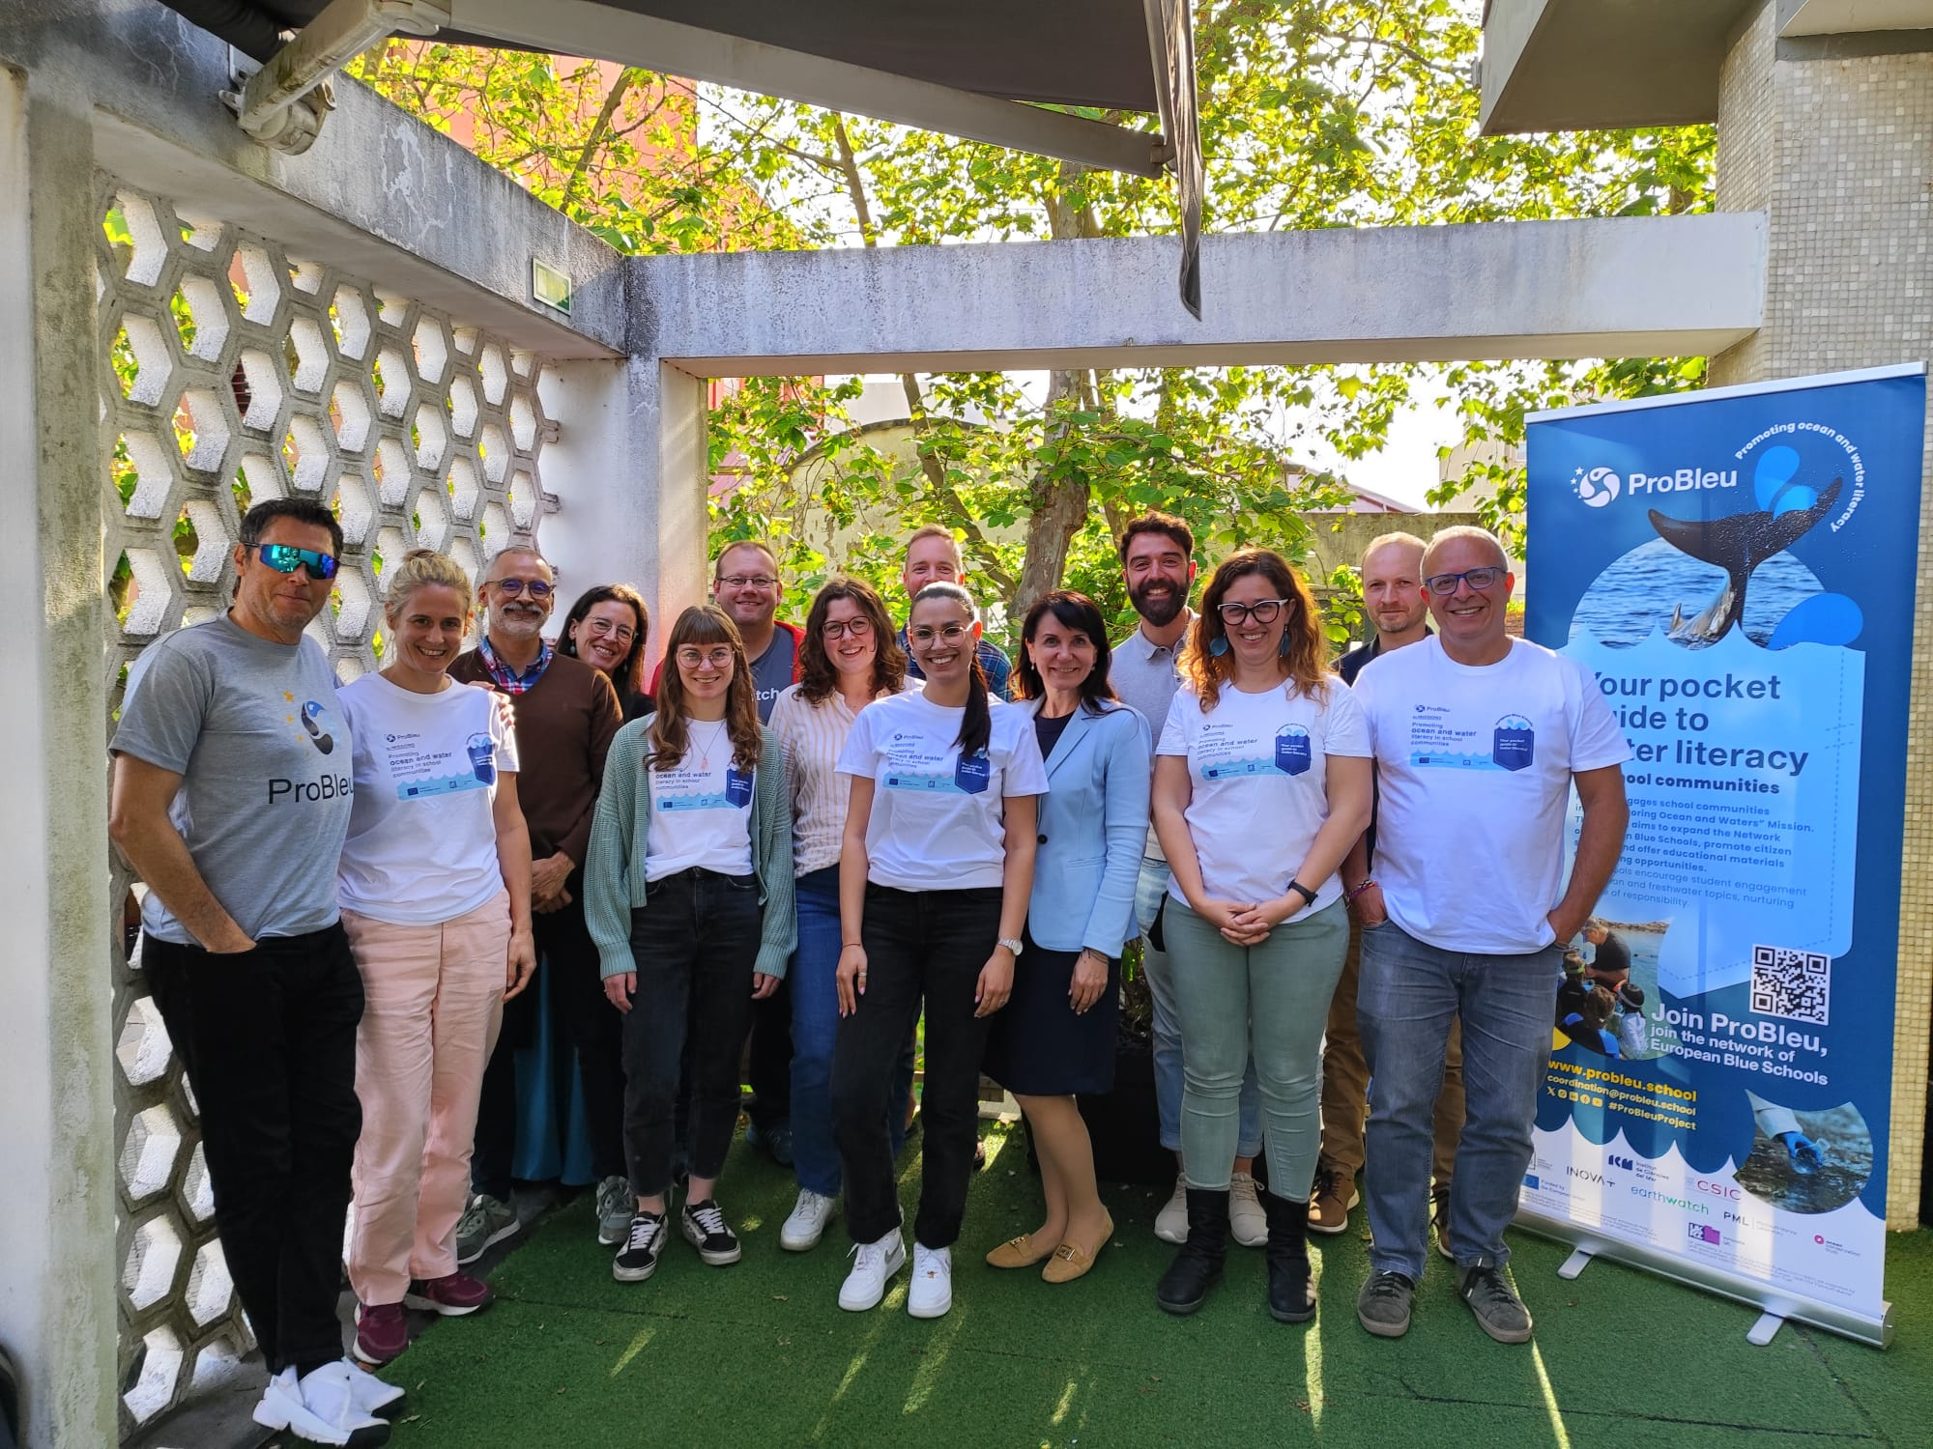
Thank you for listening. Any Questions?
Keep up to date with ProBleu via our socials:
Twitter - @pro_bleu
LinkedIn - @Probleu Project
Instagram - probleu.school
Youtube - @ProBleu.school
We look forward to receiving your application!

